Slide 1

Prince Hall Shriners Foundation, Inc.
A Helping Hand to our Communities
Foundation Overview
“Strengthening Communities. Ensuring Accountability. Driving Impact.”

Slide 2
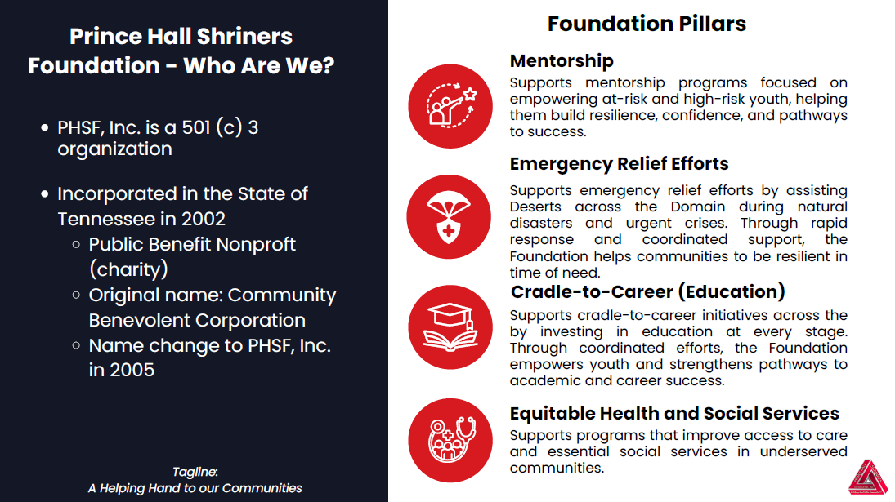
Notes:
The Prince Hall Shriners Foundation, Inc. (PHSF, Inc.) was first incorporated under the name Community Benevolent Corporation (CDC) on January 3, 2002, under the leadership of our William F. Crockett. Originally, for the purpose of the AEAONMS, Inc. National Diabetes Initiative. Our name was changed to the Prince Hall Shriners Foundation, Inc. on July 19, 2005. Since our inception, the PHS Foundation has been steadfast and unmovable in its commitment to serving communities near and far. More significantly, the Foundation partnered with AEAONMS, Inc to support HBCU’s by donating almost $85,000 since 2021. The foundation has also partnered with AEAONMS, Inc to support their Annual Session Bookbag and School Supply giveaway every August by raising funds totaling over $58K and donating over 6,500 Bookbags and School Supplies. PHSF, Inc. provides assistance to communities affected by natural disasters and makes contributions to other non-profit organizations to support their objectives and mission.

Slide 3
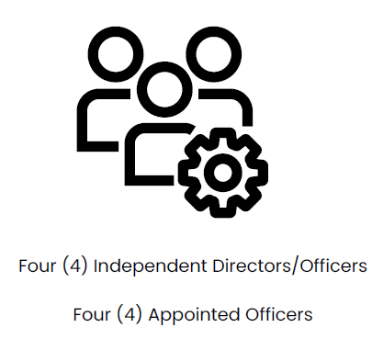
Prince Hall Shriners Foundation, Inc.
LEGAL STRUCTURE
GOVERNANCE STRUCTURE
No owners; governed by a Board of Directors
Operates under Tennessee nonprofit law
Board Duties:
  Act in good faith
  Avoid conflicts of interest
  Make informed decisions
  Assets must remain dedicated to charitable purposes

Slide 4
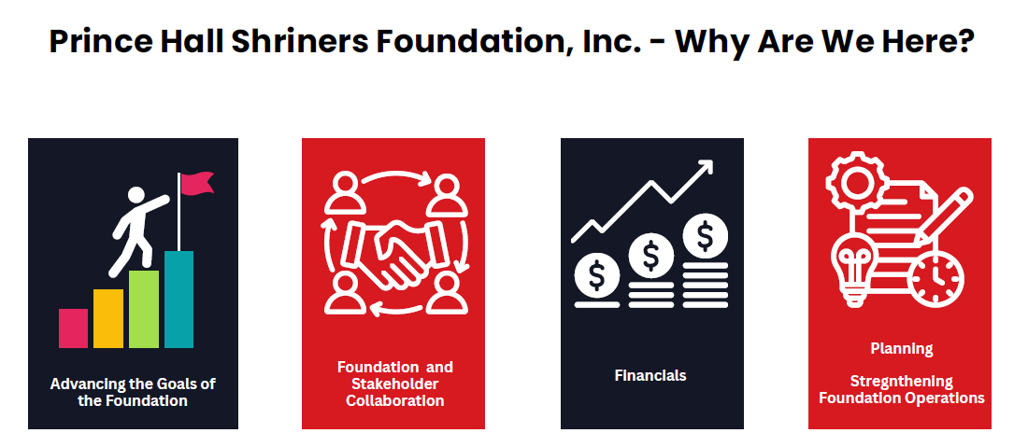

Slide 5
Prince Hall Shriners Foundation, Inc.
MISSION STATEMENT
PHSF, Inc. is committed to mentoring youth, advancing cradle-to-career education, providing emergency relief, and promoting equitable health and social services. Through advocacy and strategic partnerships, we uplift communities and address disparities to foster lasting well-being.

Slide 6
Prince Hall Shriners Foundation, Inc.
VISION STATEMENT
PHSF, Inc. envisions communities where everyone has equitable access to education, opportunity, and essential services. Through collaboration and empowerment, we aim to unlock potential and drive lasting change.

Slide 7
Prince Hall Shriners Foundation, Inc.
PARTNERING IN COMMUNITY
The PHSF, Inc. partners with Temples and Courts across the Domain by providing fiscal sponsorship, administrative support, and financial oversight to help carry out approved charitable projects that align with the Foundation’s mission.

Slide 8
Prince Hall Shriners Foundation, Inc.
HOW DOES THE PARTNERSHIP WORK
PHSF, Inc. serves as a fiscal sponsor to Temples and Courts by allowing qualified charitable projects to operate under its 501(c)(3) status - receiving and managing tax-deductible donations.
THERE IS NO COST FOR THIS SERVICE

Slide 9
Prince Hall Shriners Foundation, Inc.
HOW DOES THE FOUNDATION ACCOUNT FOR FUNDS COLLECTED ON BEHALF OF PROJECTS?
PHSF, Inc. keeps clear and accurate records of every donation, tracking each project separately to make sure the money is used only for the purpose it was given and follows donor and IRS rules.

Slide 10

PARTNERING WITH THE PRINCE HALL SHRINERS FOUNDATION, INC.
Email AEAONMS, Inc. Corporate Affairs Department at corporateaffairs@aeaonms.org to discuss your community service project. They serve as the main contact between the Foundation (PHSF, Inc.), AEAONMS Departments, Deserts, Temples, and Courts.

Slide 11
PARTNERING WITH THE PRINCE HALL SHRINERS FOUNDATION, INC.
Corporate Affairs will review your project and let you know if it fits within the charitable mission of both PHSF, Inc. and AEAONMS, Inc.
If your project is approved, they will give you permission and instructions on how to move forward with the Foundation.

Slide 12
PARTNERING WITH THE PRINCE HALL SHRINERS FOUNDATION, INC.
Requests must include a detailed synopsis of the charitable project/event:
Must have a clear explanation of your project's mission and intended activities.
How it aligns with the PHSF, Inc. mission.
Demonstrate the project is charitable in purpose and operating for a community need.
Provide an estimate of your project’s anticipated income and expenses which helps the Foundation understand the scope of the administrative work needed to support your project.
The project should not be organized or operated for the benefit of private interests.

Slide 13
PARTNERING WITH THE PRINCE HALL SHRINERS FOUNDATION, INC.
After you submit your request, the Foundation will begin its review process. Please allow 3 to 14 days from the date you submit your request to receive a decision and response.
The Officers of the Foundation will review the request to determine if it should go to the Board for a vote. If yes, then:
The Board reviews the submission and votes on the Request.
After the Board votes, the Foundation will inform the submitter of the Board’s Decision and next steps.

Slide 14

GOT QUESTIONS? WE GOT ANSWERS!
If you have any questions, please email them to:
info@princehallshrinersfoundation.org

